Slide 1


Slide 2

The Inter-American Division
P u b l i s h i n g S y s t e m
N 06
Inter American Division Publishing System’s Administrative Relations, Financing and Operations

Slide 3
N 06 01
Inter American Division Publishing System’s Maximum Operative Organism.
The maximum administrative organism of the Inter American Division’s Publishing System is constituted by the Inter American Division’s Publishing Board, according to what N 02 20 establishes, where this administrative organism’s responsibilities and attributes are outlined.

Slide 4
N 06 02
Other Administrative Organism of the Inter American Division’s Publishing System.
The Inter American Division’s Publishing System’s Administrative Organisms are dependent on the basic functions that this document defines for the Publish System, according to what is established in section N 02 02, which defines the attributes of the Publishing System, and section N 02 06, titled: Administrative Function : Strategic Mission. This section indicates the following:
a. Strategic Mission Function.
This function is performed by:
1.-The Inter American Division’s Publishing System’s Board. N 02 06
2.-The Union’s Publishing System’s Board. N 02 55 y N 02 60
3.-The Publishing Board of the Local Field. N 02 70
4.-The Board of Director of the Publishing Houses. N 08 …
b. Administrative – Operative Function.
This function is performed by:
1.-The Inter American Division Publishing Ministry Department. N 02 40
2.-The Union’s Publishing Ministry Department. N 02 75
3.-The Publishing Houses’ Administrative Body. N 02 …

Slide 5
N 06 03
Administrative Attributes of the Components of the Inter American Division’s Publishing System.
In order to achieve the objectives of the Inter American Division’s Publishing System, this system’s activities are assigned in the following manner:

Slide 6
Decision Making – Within Strategic – Administrative Environments, founded on the mission focus described in section N 01. These activities are assigned to the Inter American Division’s Publishing Ministry Department, to the Union’s Publishing Ministry Department, to the Local Field’s Publishing Ministry Department and to the Publishing Houses.
Production, Marketing, Promotion and Sale of Evangelistic Publications. These activities are assigned to the publishing Houses.
Recruitment, Skill building, Training, Supervision, Evaluation and Promotion of the sales workforce that the Literature Evangelists represent. These activities are assigned to the inter American Division’s, Unions and Local Fields Publishing Ministry Department.
Distribution Channels Design in closer relation with the geographic market realities represented in Inter America, and with the objective that the evangelistic publications be more accessible to the end-user. These activities are assigned to the Publishing Houses.
Professionalizing the activities so the contact with the end-user of the evangelistic publications is more oriented to a missionary and redemptive activity. These activities are assigned to the Publishing Ministry Department of the Inter American Division, of the Unions and of the Local Fields.
Connections between the Inter American Division, the Unions, the Local Fields, the Pastors, and Local Churches so that God’s plan for the Publications is applied, and the members use the materials for evangelizing and for their growth and spiritual maturity. These activities are assigned to the Publishing Ministry Departments of the Inter American Division, the Unions and the Local Fields.

Slide 7
N 06 04
Applicable Financing Principles of the Inter American Division’s Publishing System.

Slide 8
1
Cada parte integrante dentro del sistema de publicaciones tiene una participación en el financiamiento del modelo.
Each component part in the system of publications has a stake in the financing model.
Chaque partie intégrante du système de publication apporte sa contribution dans le financement du modèle.

Slide 9
2
El diezmo es una fuente de fondos en la formación profesional y espiritual del Colportor Evangélico, como una estrategia evangelizadora. Q 13 -4
Tithing is a source of funds for vocational and spiritual training for the Colporteur Ministry, as an evangelistic strategy. Q 13-4
La dîme est une source de fonds, en tant que stratégie d'évangélisation, dans la formation professionnelle et spirituelle du Colporteur évangélique. Q 13-4

Slide 10
3
El Campo Local asume, como una de sus funciones básicas dentro de sus estrategias evangelizadoras, el apoyo completo del sistema de colportaje.
The Local Conference assumes full support for the Colporteur Ministry as one of its basic functions, as part of its evangelistic strategy.
Le Champ local assume le soutien total du système de colportage, en tant que l'une de ses principales fonctions dans le cadre de ses stratégies d'évangélisation.

Slide 11
4
La formación profesional y espiritual del Colportor Evangélico es responsabilidad básica del nivel vertical de la Iglesia.
The vocational and spiritual training for the Colporteur Ministry is a basic responsibility of the vertical hierarchy of the Church.
La formation professionnelle et spirituelle du Colporteur évangélique est une responsabilité fondamentale de la structure verticale de l'église.

Slide 12
5
La operación del sistema de distribución es una función básica de las Casas Publicadoras, y esta define las formas y modelos para su administración, dependiendo de los diferentes entornos legales y fiscales donde operen.
Operation of the distribution system is a basic function of the Publishing Houses, and this defines the forms and models for their administration, depending on the different legal and fiscal contexts in which they operate.
L'exploitation du réseau de distribution est une fonction de base des maisons d’édition, et celles-ci définissent les formes et les modèles de leur gestion en fonction des différents environnements juridiques et fiscaux de l’endroit où elles opèrent.

Slide 13
6
El precio de venta del producto, tanto de las Casas Publicadoras como de sus Centros de Ventas, no tiene participación en el financiamiento de los beneficios del Colportor.
The retail price of the product, both for the Publishing Houses and Sales Centers, has no stake in the financing of the Colporteur benefits.
Le prix de vente du produit, que ce soit celui des maisons d’édition que celui de leurs centres de ventes, n’inclue pas de participation au financement des avantages du Colporteur.

Slide 14
7
Todo beneficio a recibir por el Colportor Evangélico está basado en un porcentaje de utilidades operativas, tanto de las Casas Publicadoras así como de sus Centros de Ventas.
Any benefit received by the Colporteur Ministry is based on a percentage of operating profit, both from the Publishing Houses and Sales Centers.
Chaque avantage que peut recevoir le Colporteur évangélique est basé sur un pourcentage des bénéfices opérationnels dégagés tant par les maisons d’édition que par leurs centres de ventes.

Slide 15
8
El Colportor Evangélico no participa directamente en el financiamiento de sus beneficios.
The Colporteur Ministry is not directly involved in the financing of its benefits.
Le Colporteur évangélique ne participe pas directement au financement de ses prestations.

Slide 16
9
El Colportor Evangélico podrá acceder a participar en un Plan de Retiro de Beneficios Definidos, dependiendo de sus niveles de clasificación. La fuente de fondos para este beneficio se ubica dentro de la utilidad operativa de las Casas Publicadoras.
The Colporteur Ministry may be entitled to a Retirement Plan of Defined Benefits, depending on the levels of classification. The source of funding for this benefit is included within the operating profit of the Publishing Houses.
Le Colporteur évangélique pourra participer à un régime de retraite de prestations définies selon son niveau de classification. La source de financement pour cette prestation provient des bénéfices opérationnels des maisons d’édition.

Slide 17
10
La eficiencia en la operación de cada entidad administrativa que participa en el sistema de publicaciones es el fundamento para el financiamiento de los beneficios al Colportor.
The operating efficiency of each administrative entity that participates in the publication system is the basis for financing the benefits to the Colporteur.
L’efficacité opérationnelle de chaque entité administrative qui participe au système de publication est à la base du financement des avantages du Colporteur.

Slide 18
11
Las partes integrantes del Modelo de Financiamiento son:
Los tipos y niveles de beneficios para el Colportor Evangélico,
El Colportor Evangélico y sus clasificaciones,
las fuentes de fondos,
las organizaciones participantes en el financiamiento y las organizaciones administradoras de fondos.
The component parts of the Financing Model Publications Ministry are: The types and levels of benefit for the Colporteur Ministry,
the Colporteur Ministry and its classifications,
the sources of funds,
the organizations involved in financing and
the fund management organizations.
Les parties intégrantes du modèle de financement sont :
les types et niveaux de prestations pour les Colporteurs évangélique,
le Colporteur évangélique et ses classifications,
les sources de fonds,
les organismes participants au financement et
les organismes gestionnaires de fonds.

Slide 19
12
La administración de los fondos que sustentan la viabilidad del Modelo de Financiamiento es responsabilidad de la estructura vertical de la Iglesia.
The administration of the funds that support the viability of the Funding Model is the responsibility of the vertical structure of the Church.
La gestion des fonds qui étayent la viabilité du modèle de financement est de la responsabilité de la structure verticale de l'église.

Slide 20
N 06 05
The Inter American Division’s, the Unions’ and the Local Fields’ Participation in the Financing of the Model and of the Benefits of the Literature Evangelists
N 06 06
The Publishing Houses’, its Subsidiaries’ and Bookstores’ Participation in the Financing of the Model and of the Benefits of the Literature Evangelists

Slide 21
IDENTIFYING THE FUNDING MODEL
PUBLISHING SYSTEM - INTEGRATING PARTS
1
2
3
4
5
Type and Level
Benefits
Literature
Evangelists
Classification
Funding
Source
Funding Organization
Fund
Manager
B
$
$
$

Slide 22

FINANCING THE BENEFITS OF LITERATURE EVANGELISTS
DISTRIBUTION OF FUNDS
Funding
Source
Funding
Source
$
Funding Organization
$
$
IAD
UNIONS
LOCAL FIELDS
PUBLISHING HOUSES
BOOK STORES
N/TITHE
TITHE
22 UNIONS
T$
NT$
B
B
BASIC FUND
45 %
LOCAL FIELDS
LEADERSHIP FUND
70 %
LOCAL FIELDS
Fund
Manager
SPIRITUAL FORMATION FUND
35 %
UNIONS
COURTESY FUND
5 %
PUBLISHING HOUSES
$
BENEFITS PLAN FOR COLPORT0RS
20 %
IAD
PROFESIONAL TRAINING FUND
25 %
UNIONS

Slide 23

IAD
UNION
$
Funding Organizations
LOCAL
FIELD
Participation in the Financing of the Model and of the Benefits of the Literature Evangelists

Slide 24
IAD
N 06 05
Inter - American Division level:
The Inter American Division will be responsible for financing the Publishing Ministry Department, including the Director’s and the Associate Director’s (if it were the case) salaries, benefits and taxes, as well as traveling expenses.
The IAD will share in the financing of the Literature Evangelist benefits, 5% of its net operations income, the resulting increment in tithe of the territory of the immediately preceding year. This amount should be registered in the Operations Budget approved by the Board.
The amount resulting from the above formula (N 06 05 1 b) will be distributed according to the tithe increment applicable to each Union in the territory.

Slide 25
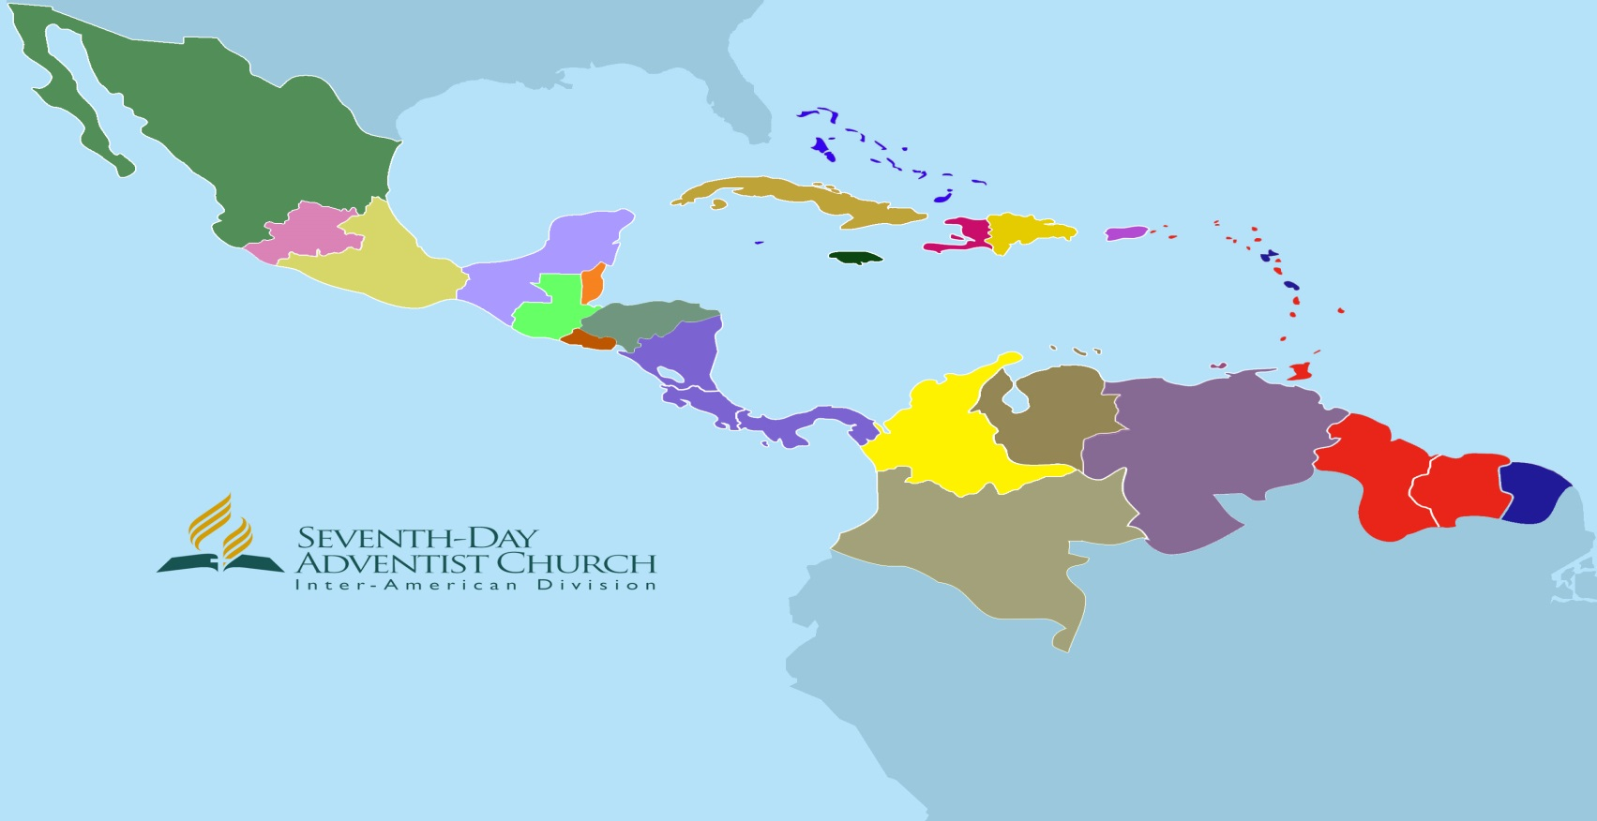
Explanation N 06 05 – 1. b
The IAD will share in the financing of the Literature Evangelist benefits, 5% of its net operations income, the resulting increment in tithe of the territory of the immediately preceding year. This amount should be registered in the Operations Budget approved by the Board.
Tithe collected in the IAD Territory 2012 - $ 230,339,649
IAD Operating Income - $ 230,339,649 X 0.06 = $ 13,820,379
Tithe collected in the IAD Territory 2013 - $ 244,375,346
IAD Operating Income - $ 244,375,345 X 0.06 = $ 14,662,521
Net Operating Income -- $ 13,820,379- $ 14,662,521 = $ 842,142
5 % net operating Income = $ 842,142 X 5 % = $ 42,107
Amount should be registred in the Operating Budget approved by the IAD Board = $ 42,107

Slide 26
Explanation N 06 05 – 1. c
The amount resulting from the above formula (N 06 05 1 b) will be distributed according to the tithe increment applicable to each Union in the territory.
Official Reported Collected Tithe in the corresponding Union Territory 2012 $ 5,000,000 ( Registered to calculate the IAD Operating Income)
Official Reported Collected Tithe in the corresponding Union Territory 2013 $ 5,500,000 ( Registered to calculate the IAD Operating Income)
Applicable increment of Tithe to corresponding Union = $ 5,500,000 / $ 5,000,000 = 10 %

Slide 27
N 06 05
UNION
Union level:
The Union will be responsible for financing the Publishing Ministry Department, including the Director’s and the Associate Director’s (if it were the case) salaries, benefits and taxes, as well as traveling expenses.
The Union will share in the financing of the Literature Evangelist’s benefits. 5% of its net operations income, the resulting increment in tithe of the territory of the immediately preceding year. This amount should be registered in the Operations Budget approved by the Board. This amount will be distributed and assigned by the Union as it is established in these policies.
The amount resulting from the above formula (N 06 05 2 b) will be distributed according to the tithe increment applicable to each Local Field in the territory.

Slide 28
Explanation N 06 05 – 2. b
The Union will share in the financing of the Literature Evangelist’s benefits, 5% of its net operations income, the resulting increment in tithe of the territory of the immediately preceding year. This amount should be registered in the Operations Budget approved by the Board. This amount will be distributed and assigned by the Union as it is established in these policies.
Tithe collected in the Union Territory 2012 ( Local Currency)- $ 5,000,000
Union Operating Income - $ 5,000,000 X 0.10 = $ 500,000
Tithe collected in the Union Territory 2013 ( Local Currency) $ 5,500,000
Union Operating Income - $ 5,500,000 X 0.10 = $ 550,000
Net Operating Income -- $ 550,000 - $ 500,000 = $ 50,000
5 % net operating Income = $ 50,000 X 5 % = $ 2,500
Amount should be registred in the Operating Budget approved by the Union Board = $ 2,500

Slide 29
Explanation N 06 05 –2. c
The amount resulting from the above formula (N 06 05 2 b) will be distributed according to the tithe increment applicable to each Local Field in the territory.
Official Reported Collected Tithe in the corresponding Local Field Territory 2012 $ 500,000 ( Registered to calculate the Union Operating Income)
Official Reported Collected Tithe in the corresponding Local Field Territory 2013 $ 550,000 ( Registered to calculate the Union Operating Income)
Applicable increment of Tithe to the corresponding Local Field = $ 500,000 / $ 550,000 = 10 %

Slide 30
N 06 05
LOCAL
FIELD
Local Field level:
The Local Field will be responsible for financing the Publishing Ministry Department, including the Director’s and the Associate Director’s (if it were the case) salaries, benefits and taxes, as well as traveling expenses.
Provide and finance sufficient physical space within its territory for the Subsidiaries’ and the Bookstores’ operations. (Where the system is operated as one entity in a Union, the union is responsible to provide adequate space.
The Local Field will share in the financing of the Literature Evangelist benefits 1% of the total amount of tithe collected with its territory, from its churches and congregations as well as from the personnel within its territory. This amount should be registered in the Operations Budget approved by the Board. This amount will be distributed and assigned by the Union as it is established in these policies..

Slide 31
N 06 06
PUBLISHING HOUSE
BOOK STORES
The Publishing Houses’, its Subsidiaries’ and Bookstores’ Participation in the Financing of the Model and of the Benefits of the Literature Evangelist
The Publishing Houses will assign, for the purposes defined in these Policies, within the Operations Budget approved by the Board, 15% of the operations net earnings of the immediately preceding year, before tithe, from Financial Statements properly audited by the General Conference Auditing Services.

Slide 32
N 06 06
PUBLISHING HOUSE
BOOK STORES
The Publishing Houses’, its Subsidiaries’ and Bookstores’ Participation in the Financing of the Model and of the Benefits of the Literature Evangelist
The Publishing Houses will distribute the previously identified percentage (N 06 06 1) according to the sales levels registered for each Union within its geographic market. Each one of these resulting amounts will be assigned to the funds that will be identified in these present Policies.

Slide 33
N 06 06
PUBLISHING HOUSE
BOOK STORES
The Publishing Houses’, its Subsidiaries’ and Bookstores’ Participation in the Financing of the Model and of the Benefits of the Literature Evangelist
The Publishing Houses will assign the Tithe of the operating net earnings of the immediately preceding year, for the purposes defined in these Policies, within the operating budget approved by their Board, in their Financial Statements appropriately audited by the General Conference Auditing Services.
The Publishing Houses will distribute the amount of the previously identified Tithe according to the sales levels registered for each of the Unions within their geographic markets. Each of the resulting amounts will be assigned to the funds identified in these Policies.

Slide 34
N 06 06 – 4 - Explanation
Para las Casas Publicadoras.
En cuanto al Ingreso de Operaciones.
Tomar en cuenta el Sistema de Distribución.
Identificar el ingreso de Operaciones en función del Sistema de Distribución, esto es, en función de la puerta de acceso de las ventas. Esto nos permitirá ir observando las nuevas tendencias que se abren en la administración de Cada Casa Publicadora.
En cuanto a esto, identificar cada uno de los principales Puntos de Venta que se identifican en el Sistema de Distribución, así como las ventas que ingresan a cada Casa Publicadora por conducto de cada Punto de Venta, y al hacer esto, agruparlos por Unión.
Tomar en cuenta el mercado del producto.
Tomar en cuenta los productos que se compran por los Colportores en cada Punto de venta.
Tomar en cuenta los productos que se compran por la Iglesia.

Slide 35
N 06 06
PUBLISHING HOUSE
BOOK STORES
The Publishing Houses’, its Subsidiaries’ and Bookstores’ Participation in the Financing of the Model and of the Benefits of the Literature Evangelist
The Publishing Houses will assign for each subsidiary organizations like book store, etc., in the Operating Budget approved by their Boards, for the purposes defined in these Policies, an 80% of the resulting operating net earnings of the immediately preceding year, before Tithe, in the Financial Statement duly audited buy the General Conference Auditing Services or by the auditing system designated by the Inter American division.

Slide 36
N 06 06 – 5
Explanation
PUBLISHING HOUSE
BOOK STORES
The Publishing Houses’, its Subsidiaries’ and Bookstores’ Participation in the Financing of the Model and of the Benefits of the Literature Evangelist
Cada Casa Publicadora presentará a su Comisión de Finanzas el Presupuesto de Operaciones, incluyendo el Presupuesto de Operaciones de su Sistema de Distribución. El Presupuesto de Operaciones de los Sistemas de Distribución será identificado por Union y Campo Local.
Se espera que la información financiera ( Estados de Resultados ) se produzcan en función de este requerimiento.

Slide 37
N 06 06
PUBLISHING HOUSE
BOOK STORES
The Publishing Houses’, its Subsidiaries’ and Bookstores’ Participation in the Financing of the Model and of the Benefits of the Literature Evangelist
The Publishing Houses will distribute the previously identified percentages among the Unions where the Subsidiaries are located, depending on their geographic markets. Each of the resulting amount will be assigned to the funds identified in these Policies.

Slide 38
N 06 06
PUBLISHING HOUSE
BOOK STORES
The Publishing Houses’, its Subsidiaries’ and Bookstores’ Participation in the Financing of the Model and of the Benefits of the Literature Evangelist
The Publishing Houses will assign within their Operating Budgets approved by their Boards, and for the purposes defined in these Policies, the Tithe of the Operating Net earnings from the immediately preceding year, and for each of their Subsidiaries and Bookstores, in the Financial Statements audited by the General Conference Auditing Services or by the Auditing System designated by the Inter American Division.

Slide 39
N 06 06
PUBLISHING HOUSE
BOOK STORES
The Publishing Houses’, its Subsidiaries’ and Bookstores’ Participation in the Financing of the Model and of the Benefits of the Literature Evangelist
The Publishing Houses will distribute among the Unions where the Subsidiaries and the Bookstores are located, the previously identified Tithe amounts according to its geographic market. Each one of the resulting amounts will be assigned to the funds identified in these Policies.

Slide 40
N 06 06
PUBLISHING HOUSE
BOOK STORES
The Publishing Houses’, its Subsidiaries’ and Bookstores’ Participation in the Financing of the Model and of the Benefits of the Literature Evangelist
Financing the Operations of the Subsidiaries and the Bookstores, as part of the Distribution System.
It is expected that the Subsidiaries and the Bookstores, as part of the basic Distribution System, depending on the Publishing Houses, be financially self-sufficient, since their responsibilities include the salaries and benefits of their personnel, as well as the benefits of the Literature Evangelists within their geographic markets.

Slide 41
B
N 06 07
Literature Evangelist Benefits. Operation and Financing.
The benefits identified in these Policies for the Literature Evangelist will be awarded to them on a Quarterly basis, according to the register kept and updated by the Subsidiaries, the Bookstores and the Local Fields’ Publishing Ministry Department.

Slide 42
B
N 06 07
Literature Evangelist Benefits. Operation and Financing.
Each Subsidiary and each Bookstore will generate a Monthly Report for each one of the Literature Evangelist within their geographic markets, which will be sent to the Local Fields’ Publishing Ministry Department. This Monthly Report will be defined and designed jointly by the Publishing Houses and the Inter American Division’s Publishing Ministry Department.

Slide 43
B
N 06 07
Literature Evangelist Benefits. Operation and Financing.
The available benefits, depending on the standards defined in these Policies, will be covered according to the measure and availability of funds registered and maintained for these purposes.

Slide 44
B
N 06 07
Literature Evangelist Benefits. Operation and Financing.
The available benefits, depending on the standards defined in these Policies, will be covered according to the categories or classes of the Literature Evangelist, as these are defined in these Policies.

Slide 45
B
N 06 07
Literature Evangelist Benefits. Operation and Financing.
The Inter American Division’s Publishing Ministry Department will categorize and/or classify the Literature Evangelist within the standards defined in these Policies. These categories and/or classifications will be the basis for granting the benefits.

Slide 46
B
N 06 07
Literature Evangelist Benefits. Operation and Financing.
The Literature Evangelist benefits are classified in the following manner:
Retirement. Retirement benefits plan.
Basic benefits. These are those that have a direct relation to the standards of living and to the amount of his/her earnings. They include the following:
Educational benefits.
Medical benefits.
Rent benefits.
Transportation benefits.
Vacations.

Slide 47
B
N 06 07
Literature Evangelist Benefits. Operation and Financing.
The Literature Evangelist benefits are classified in the following manner:
Retirement. Retirement benefits plan.
Basic benefits.
Indirect or Professional training benefits. These are the indirect benefits received by the Literature Evangelist part of this/her professional formation, so that the contact with the publications’ end-user is oriented toward a professional activity. These include the following:
Training programs.
Evaluation meetings. Literature Evangelist and Associate Directors.
Special meetings.

Slide 48
B
N 06 07
Literature Evangelist Benefits. Operation and Financing.
The Literature Evangelist benefits are classified in the following manner:
Retirement. Retirement benefits plan.
Basic benefits.
Indirect or Professional training benefits.
Indirect or Spiritual Formation benefits. These are the indirect benefits received by the Literature Evangelist as part of his/her spiritual [professional (sic)] so that the contact with the publications’ end-user is oriented toward a missionary and redemptive activity. These include the following:
Congresses attendance
Spiritual retreats

Slide 49
B
N 06 07
Literature Evangelist Benefits. Operation and Financing.
The Literature Evangelist benefits are classified in the following manner:
Retirement. Retirement benefits plan.
Basic benefits.
Indirect as Professional training benefits.
Indirect as Spiritual Formation benefits.
BB
BENEFITS PLAN FOR COLPORTORS
BASIC BENEFITS
PROFESIONAL TRAINING
SPIRITUAL FORMATION

Slide 50
B
N 06 07
Literature Evangelist Benefits. Operation and Financing.
BB
Educational benefits.
Medical benefits.
Rent benefits.
Transportation benefits.
Vacations.
BENEFITS PLAN FOR COLPORTORS
BASIC BENEFITS
SPIRITUAL FORMATION
Congresses attendance
Spiritual retreats
PROFESIONAL TRAINING
Training programs.
Evaluation meetings. Literature Evangelist and Associate Directors.
Special meetings

Slide 51
N 06 07
$
Source of Funds.
$
TITHE
T$
N/TITHE
NT$

Slide 52
N 06 07
$
Source of Funds.
The sources of funds for the financing of the Literature Evangelist benefits is defined in the following manner:
Funds from Tithe. (T$) Stemming from the tithe of the net earnings of the Publishing Houses as well as from the Subsidiaries and the Bookstores, as well as from the Inter American Division, Unions surplus, and Local Fields’ operations, as described in these Policies.
Each union will keep an accounting record of these funds, and will register it as an assigned fund. AFO-Tithe – Literature Evangelists Benefits.
Non-Tithe Funds. (NT$) These come from the Publishing Houses’, Subsidiaries’ and Bookstores’ operation net earnings.
Each union will keep an accounting record of these funds, and will register it as an assigned fund. AFO-Non-Tithe – Literature Evangelist Benefits

Slide 53
N 06 07
Concepts to be financed according to the source of funds.
Type and Level
Benefits
Literature
Evangelists
Classification
Funding
Source
Funding Organization
Fund
Manager
B
$
$
$
Benefits to be financed from Tithe Funds.
Benefits Plan for Colportors (BPC) - Benefits Plan Fund - Colportors. (BPFC)
Basic Benefits (BB). Basic Fund.(BF)
Congresses. Spiritual Formation Fund.
Spiritual Retreats. Spiritual Formation Funds.

Slide 54
N 06 07
Concepts to be financed according to the source of funds.
BB
Educational benefits.
Medical benefits.
Rent benefits.
Transportation benefits.
Vacations.
BASIC BENEFITS
$
BENEFITS PLAN FOR COLPORTORS
BPC
TITHE
T$
SPIRITUAL FORMATION
Congresses attendance
Spiritual retreats

Slide 55
N 06 07
Concepts to be financed with Non-Tithe Funds.
Type and Level
Benefits
Literature
Evangelists
Classification
Funding
Source
Funding Organization
Fund
Manager
B
$
$
$
Training Programs. Professional Training Fund. (PTF)
Evaluation meetings. Literature Evangelist and Associate Directors. Professional Training Fund. (PTF)
Special meetings. Professional Training Fund. (PTF)
Sales Incentives. Courtesy Fund. (CF)
Associate Directors’ Salaries and Benefits. Leadership Fund. (LF)

Slide 56
N 06 07
Concepts to be financed with Non-Tithe Funds.
COURTESY FUND
Sales Incentives to the Colportors
CF
$
LF
PROFESIONAL TRAINING FUND
Training programs.
Evaluation meetings.
Literature Evangelist
and Associate Directors.
Special meetings
LEADERSHIP FUND
Associate Directors’ Salaries and Benefits
N/TITHE
NT$

Slide 57
N 06 10
Funds to Finance the Literature Evangelist Benefits.
Funds Administrating Organizations.
Tithe Funds.
Benefits Plan for Colportors (Retirement Fund). For a Defined Benefits Plan, as defined in these Policies, for the Literature Evangelist thus classified in these Policies. The Inter American Division is the administrator of these funds through the Funds’ Balance Owning Organizations, according to what is defined and established in these Policies.
20% of the Total Tithe Fund is assigned to this fund.
Each Union will maintain an accounting record of these funds destined to finance the Literature Evangelist’s retirement benefit. These funds will be managed within a Balance Fund for the Literature Evangelist Benefits Plan, and will be sent to the Inter American Division’s Treasury for its control and corresponding benefits payment.

Slide 58
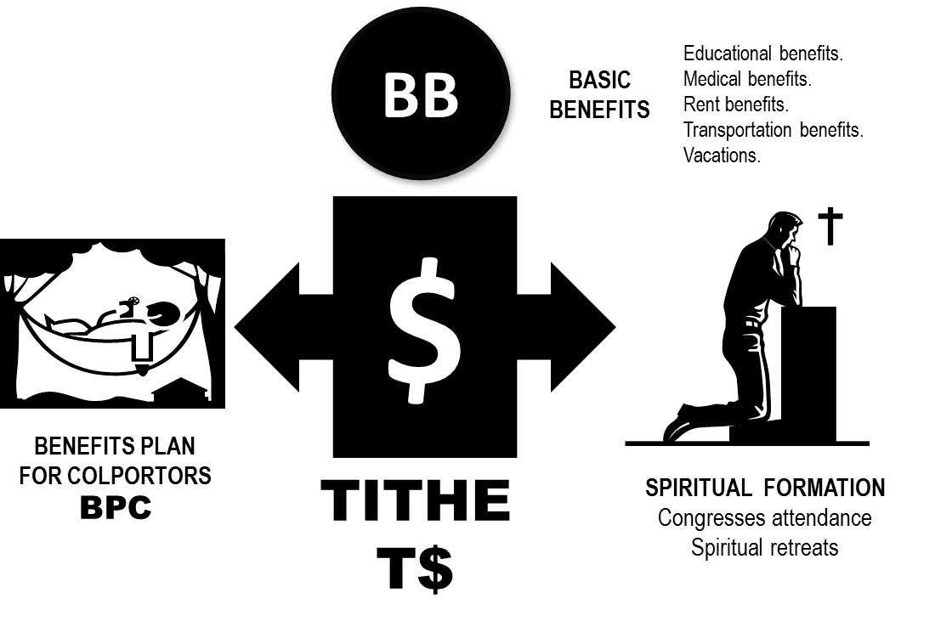
N 06 10
Funds to Finance the Literature Evangelist Benefits.
Funds Administrating Organizations.
20 %
100 %

Slide 59
N 06 10
Funds to Finance the Literature Evangelist Benefits.
Funds Administrating Organizations.
Basic Fund.
45% of the total Tithes fund is assigned to this fund.
The following benefits are financed in this fund.
Educational Assistance.
Medical Assistance.
Rent Assistance.
Transportation Assistance.
Vacations.
This fund is administered by the Local Fields. They will maintain an accounting record. The fund will be managed as an AFO-Basic Fund.

Slide 60
N 06 10
Funds to Finance the Literature Evangelist Benefits.
Funds Administrating Organizations.
45 %
20 %
100 %

Slide 61
N 06 10
Funds to Finance the Literature Evangelist Benefits.
Funds Administrating Organizations.
Spiritual Formation Fund.
35% of the total Tithe Fund is assigned to this fund.
This fund finances the indirect benefits for Spiritual Formation detailed below:
Congress attendance
Spiritual retreats
The Unions administer this fund. They will keep an accounting record. The Fund will be manages as an AFO-Spiritual Formation Fund.

Slide 62
N 06 10
Funds to Finance the Literature Evangelist Benefits.
Funds Administrating Organizations.
45 %
20 %
35 %
100 %

Slide 63
N 06 10
Funds to Finance the Literature Evangelist Benefits.
Funds Administrating Organizations.
Non-Tithe Fund.
Leadership Fund. 70% of the total non-tithe fund is assigned to this Fund.
This Fund finances the salaries and the benefits of the Associate Directors.
The Associate Director’s salary and benefits system can include the following concepts:
Salaries
Commissions
Traveling Fare Tickets
The particular countries’ ‘Social Security’. The Defined Benefits Plan coverage instance will be established by the Union’s Publishing’s System Board.
Denominational Insurances.
1) Death and Dismemberment.
2) Survivors’.
3) Disability
f. Auto insurance. Limited coverage.
g.1% Annual Purchase incentive on purchases above a ceiling established by the Local Fields’ Publishing’s System Board.
The Unions’ Publishing’s System Boards will decide as to the application of this provision; and as to the Associate Directors’ remuneration system, including the commissions.
The scale or level determination for the Associate Directors will be the prerogative of the Unions’ Publishing’s System Boards. This determination will be based on the purchase levels of the group of Literature Evangelist they supervise and counsel.
This fund will be managed as an AFO – Leadership Fund by the Local Fields.

Slide 64
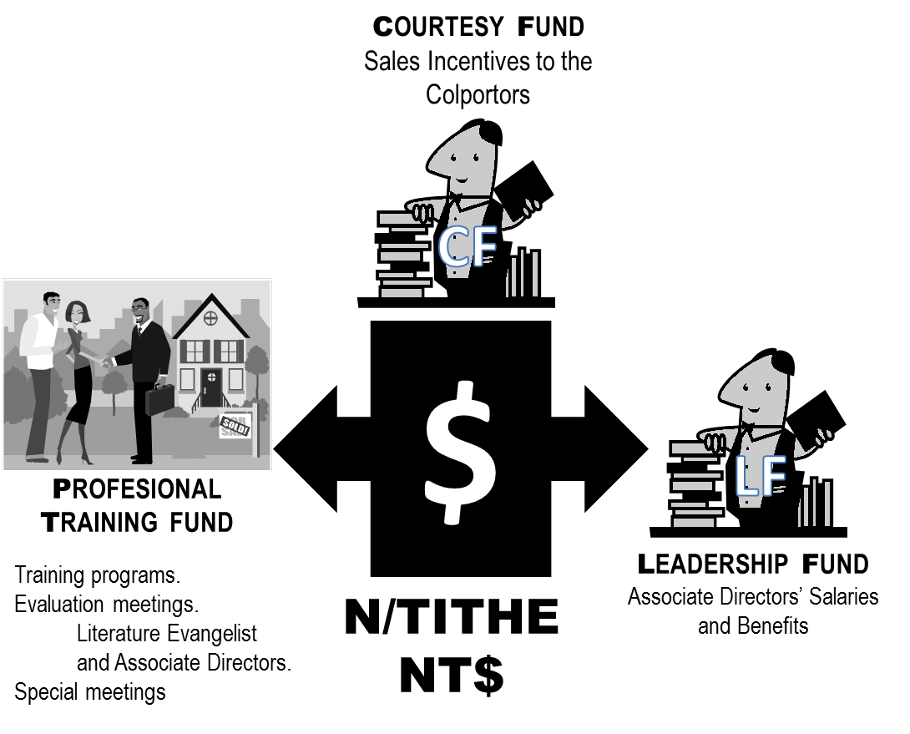
N 06 10
Funds to Finance the Literature Evangelist Benefits.
Funds Administrating Organizations.
70 %
100 %

Slide 65
N 06 10
Funds to Finance the Literature Evangelist Benefits.
Funds Administrating Organizations.
Courtesy Fund.
5% of the total Non-Tithe Funds will be assigned to this fund.
This fund finances the sales incentives for the Evangelical Colporteurs according to the standards and levels established by these Policies.
This fund is managed by the Publishing Houses. It will be recorded in the accounting records as a Reserve – Courtesy Fund.

Slide 66
N 06 10
Funds to Finance the Literature Evangelist Benefits.
Funds Administrating Organizations.
5 %
70 %
100 %

Slide 67
N 06 10
Funds to Finance the Literature Evangelist Benefits.
Funds Administrating Organizations.
Professional Formation Fund.
25% of the total Non—Tithe Funds is assigned to this fund.
This Fund finances the Professional Formation Indirect Benefits identified below:
Training Programs (Colporteur’s Schools).
Evaluation meetings. Literature Evangelist and Associate Directors.
Special meetings.
This Fund is managed by the Unions. It will be recorded in the accounting records as an AFO—Professional Formation.

Slide 68
N 06 10
Funds to Finance the Literature Evangelist Benefits.
Funds Administrating Organizations.
5 %
25 %
70 %
100 %

Slide 69
FINANCING THE BENEFITS OF LITERATURE EVANGELISTS
DISTRIBUTION OF FUNDS
Funding
Source
Funding
Source
$
Funding Organization
$
$
IAD
UNIONS
LOCAL FIELDS
PUBLISHING HOUSES
BOOK STORES
N/TITHE
TITHE
22 UNIONS
T$
NT$
B
B
BASIC FUND
45 %
LOCAL FIELDS
LEADERSHIP FUND
70 %
LOCAL FIELDS
Fund
Manager
SPIRITUAL FORMATION FUND
35 %
UNIONS
COURTESY FUND
5 %
PUBLISHING HOUSES
$
BENEFITS PLAN FOR COLPORT0RS
20 %
IAD
PROFESIONAL TRAINING FUND
25 %
UNIONS

Slide 70
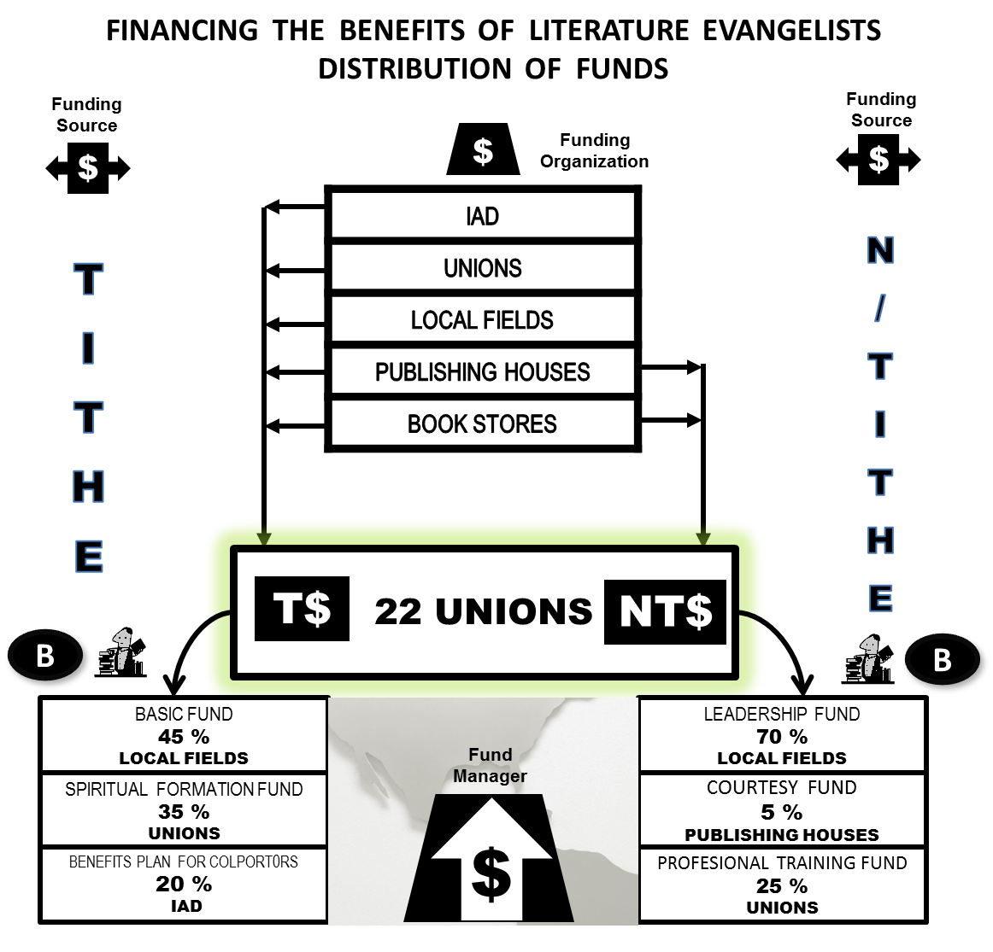
THANK YOU

